Slide 1
Regression Analysis
Poisson Regression
Nicoleta Serban, Ph.D.
Professor
School of Industrial and Systems Engineering
Predicting Demand for Rental Bikes: Poisson Regression

Slide 2

About This Lesson

Slide 3

Predicting Demand for Rental Bikes
Bike sharing systems are of great interest due to their important role in traffic management.
Dataset: Historical data for years 2011-2012 for the bike sharing system in Washington D.C.
Data Source: UCI Machine Learning Repository
Acknowledgement: This example was prepared with support from students in the Masters of Analytics program, including Naman Arora, Puneeth Banisetti, Mani Chandana Chalasani, Joseph (Mike) Tritchler and Kevin West

Slide 4
Response & Predicting Variables
The response variable is:
Y (Cnt): Total bikes rented by both casual & registered users together
The qualitative predicting variables are:
Season: Season which the observation is made (1 = Winter, 2 = Spring, 3 = Summer, 4 = Fall)
Yr: Year on which the observation is made
Mnth: Month on which the observation is made
Hr: Day on which the observation is made (0 through 23)
Holiday: Indictor of a public holiday or not (1 = public holiday, 0 = not a public holiday)
Weekday: Day of week (0 through 6)
Weathersit: Weather condition (1 = Clear, Few clouds, Partly cloudy, Partly cloudy, 2 = Mist & Cloudy, Mist & Broken clouds, Mist & Few clouds, Mist, 3 = Snow, Rain, Thunderstorm & Scattered clouds, Ice Pallets & Fog)
The quantitative predicting variables are:
Temp: Normalized temperature in Celsius
Atemp: Normalized feeling temperature in Celsius
Hum: Normalized humidity
Windspeed: Normalized wind speed

Slide 5
Poisson Regression Analysis in R
# Applying multiple linear regression model
model1 = glm(cnt ~ ., data=train, family='poisson’)
summary(model1)
⋮
---
Deviance Residuals:
Min 1Q Median 3Q Max
-24.6089 -3.7805 -0.8685 3.0436 22.6553
 | Estimate | Std. Error | z-value | Pr(>|z|)
(Intercept) | 2.93659 | 0.007629 | 384.941 | <2e-16
season2 | 0.265486 | 0.004129 | 64.298 | <2e-16
season3 | 0.255689 | 0.00473 | 54.059 | <2e-16
season4 | 0.448706 | 0.004582 | 97.918 | <2e-16
yr1 | 0.4684 | 0.001289 | 363.518 | <2e-16
mnth2 | 0.115282 | 0.004247 | 27.143 | <2e-16
mnth3 | 0.235149 | 0.004422 | 53.179 | <2e-16
mnth4 | 0.210302 | 0.005857 | 35.909 | <2e-16
mnth5 | 0.271895 | 0.006138 | 44.295 | <2e-16
mnth6 | 0.2239 | 0.006247 | 35.84 | <2e-16
In the full output there are 51 predictor rows in addition to the intercept.
All predicting variables are statistically significantly explaining the variability in the response (all p-values are small)
Inflated statistical significance is also an issue in Poisson regression when the sample size is large

Slide 6
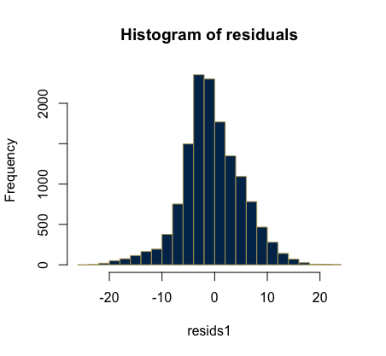
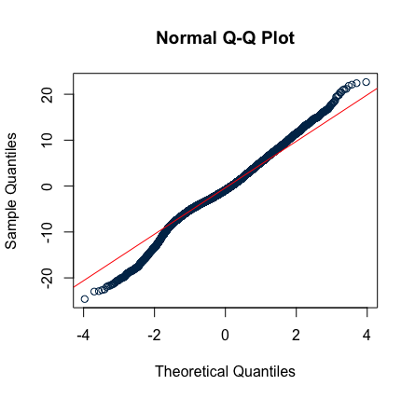
Goodness of Fit
## Checking normality
# histogram
hist(resids1,
nclass=20,
col=gtblue,
border=techgold,
main="Histogram of residuals")
# q-q plot
qqnorm(resids1,
col="gtblue")
qqline(resids1,
col="red")
# GOF Test
with(model1, cbind(res.deviance = deviance, df = df.residual,
p = pchisq(deviance, df.residual, lower.tail=FALSE)))
res.deviance df p
1458653.4 13851 0

Slide 7
Prediction
## Read New Data (Test Data)
test=data[-picked,]
test <- test[-c(1,2,9,15,16)]
## Prepare the test data the same as the training data
## Convert the numerical categorical variables to predictors in the test data
test$season = as.factor(test$season)
test$yr = as.factor(test$yr)
test$mnth = as.factor(test$mnth)
test$hr = as.factor(test$hr)
test$holiday = as.factor(test$holiday)
test$weekday = as.factor(test$weekday)
test$weathersit = as.factor(test$weathersit)
## Build a prediction for model1 with the test data
# Specify whether a confidence or prediction interval
pred = predict(model1, test, interval = 'prediction')

Slide 8
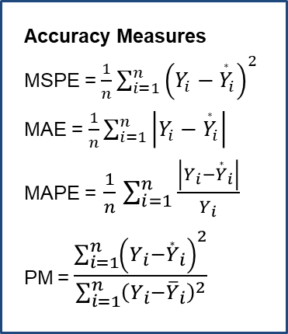
Prediction Accuracy: Model 1
## Save Predictions to compare with observed data
test.pred1 <- predict(model1, test, type='response’)
# Mean Squared Prediction Error (MSPE)
mean((test.pred1-test$cnt)^2)
[1] 8060.083
# Mean Absolute Prediction Error (MAE)
mean(abs(test.pred1-test$cnt))
[1] 59.96461
# Mean Absolute Percentage Error (MAPE)
mean(abs(test.pred1-test$cnt)/test$cnt)
[1] 0.8214892
# Precision Measure (PM)
sum((test.pred1-test$cnt)^2)/sum((test$cnt-mean(test$cnt))^2)
[1] 0.2425596
Accuracy Measures
MSPE = $\frac{1}{n}\sum_{i=1}^{n}{{\left(Y_{i}−{\overset{∗}{Y}}_{i}\right)}^{2}}$
MAE = $\frac{1}{n}\sum_{i=1}^{n}{\left|Y_{i}−{\overset{∗}{Y}}_{i}\right|}$
MAPE = $\frac{1}{n}$ $\sum_{i=1}^{n}{\frac{\left|Y_{i}−{\overset{∗}{Y}}_{i}\right|}{Y_{i}}}$
PM = $\frac{\sum_{i=1}^{n}{{\left(Y_{i}−{\overset{∗}{Y}}_{i}\right)}^{2}}}{\sum_{i=1}^{n}{{\left(Y_{i}−{\overline{Y}}_{i}\right)}^{2}}}$
Prediction Accuracy
MSPE = 8060.08
MAE = 59.96
MAPE = 0.82
PM = 0.243

Slide 9
Model Comparison
Model | MSPE | MAE | MAPE | PM
Full MLR | 10304.95 | 74.52 | 2.72 | 0.310
MLR Transformed | 8955.41 | 62.69 | 0.80 | 0.271
Poisson Reg | 8060.08 | 59.96 | 0.82 | 0.243
The Poisson regression models outperform the multi-variable linear regression models in terms of predictive power across most prediction measures except MAPE.
While the GOF test rejects the null of good fit, the deviance residuals seem approximately normally distributed.

Slide 10

Summary

